Slide 1
Student info
NAME: MEΝΑΚΑ P
REGISTER NO: 24131210500122024
NMID: ASANM121ANM12124213038
DEPARTMENT: BCA
COLLEGE IMMACULATE COLLEGE FOR WOMEN
UNIVERSITY: ANNAMALAI university

Slide 2
Project title
Student portfolio

Slide 3
Agenda
Problem statement
Project overview
End users
Tools and technology
Portfolio design and layouts
Features and functionalities
Results and screenshots
Conclusion
Github link

Slide 4
Problem statement
In today’s competitive world, students often struggle to present their skills, achievements, and projects in a structured and professional manner.The lack of a personalized digital platform creates barriers during:
Internship applications
Job recruitment processes
Academic evaluations
To overcome this challenge, a student portfolio website is essential for showcasing a student’s profile in a professional, organized, and accessible way.

Slide 5
Project overview
The project focuses on developing a responsive and professional portfolio website that highlights:
Personal details (basic info, bio, and contact)
Educational qualifications
Technical and professional skills
Projects and achievements
The portfolio is designed using HTML, CSS, and JavaScript, ensuring:A clean, modern, and attractive design
Full responsiveness across devicesSmooth navigation and user-friendly experience

Slide 6
End users
Students – To showcase their academic and professional profile effectively.
Recruiters / Employers – To evaluate student skills and projects during the hiring process.
Academic Institutions – To review and verify student records and achievements.

Slide 7
Tools and technologies
Frontend: HTML, CSS, JavaScript
Editor: Visual Studio Code
Version Control: GitHub
Testing Tools: Browser Developer Tools

Slide 8
Portfolio design and layout
The portfolio is structured into well-defined sections for clarity:
Home / Introduction – Name, role, and quick introduction.
About Me – Brief biography, interests, and career goals.
Education – Academic history and qualifications.
Skills – Technical expertise and soft skills.
Projects – Highlight of academic/personal projects with details.
Contact – Email, social links, and a contact form.

Slide 9
Features and Functionality
Fully responsive design for desktop and mobile.
Smooth navigation with organized sections.
Resume download option for quick access.
Contact form for direct communication.
Minimal yet elegant UI that prioritizes clarity and readability.

Slide 10
Results And screenshots
Successfully developed a responsive and professional student portfolio website.
Provided students with a personalized platform to showcase their academic and technical achievements.
Improved visibility and accessibility for recruiters and academic evaluators.

Slide 11
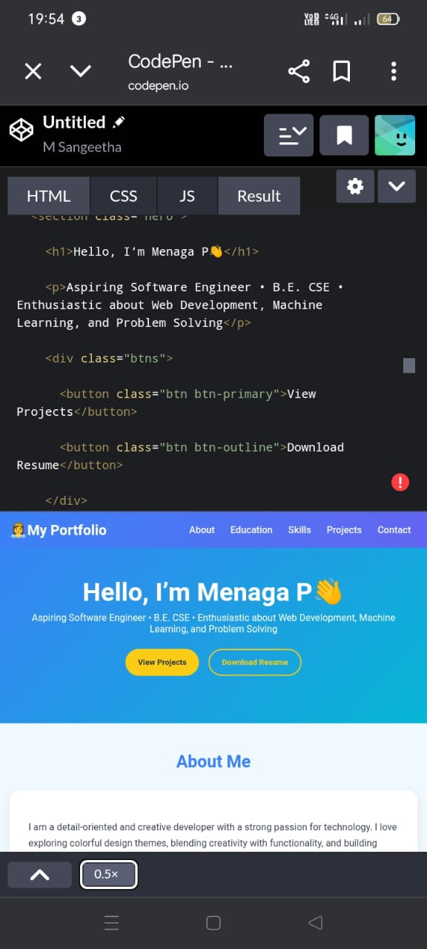
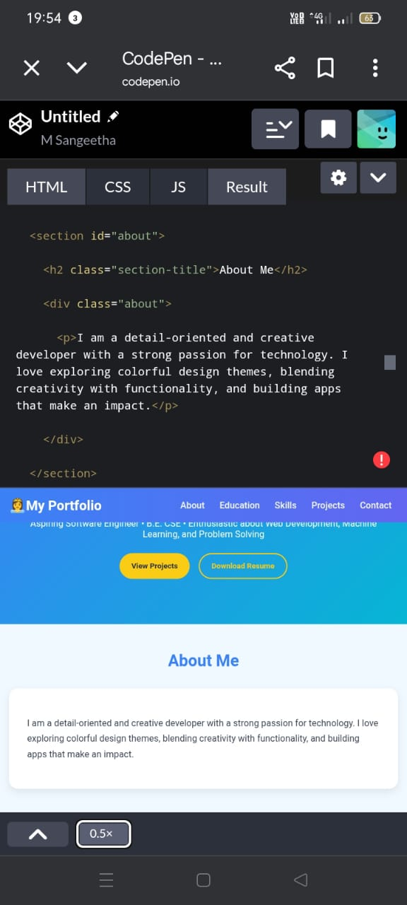
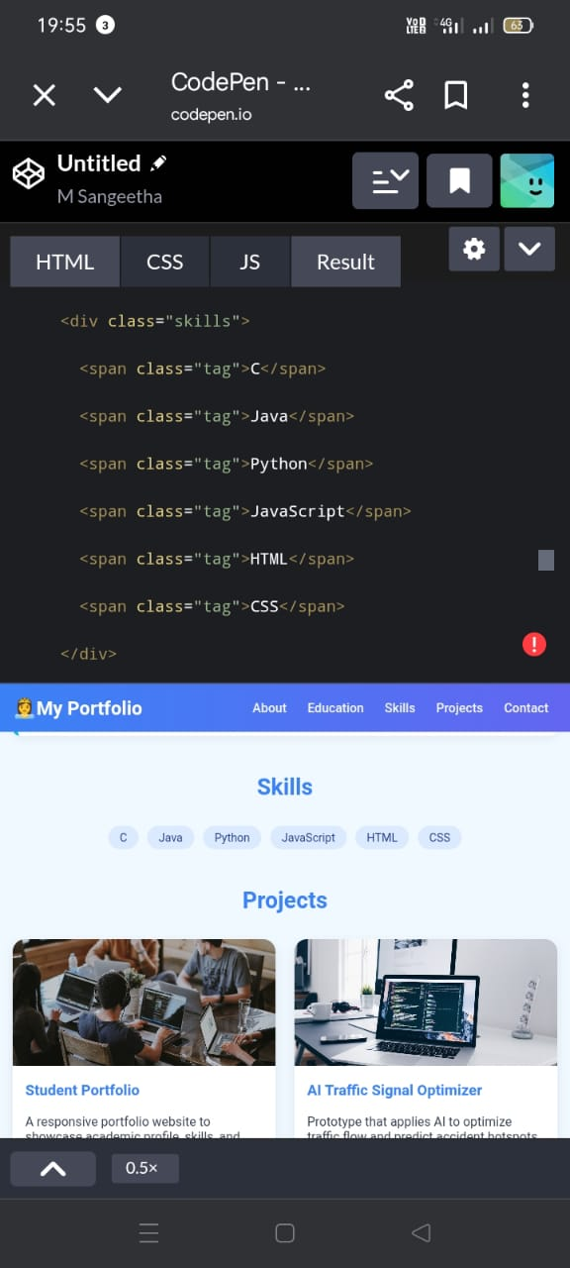
Result and screenshots

Slide 12
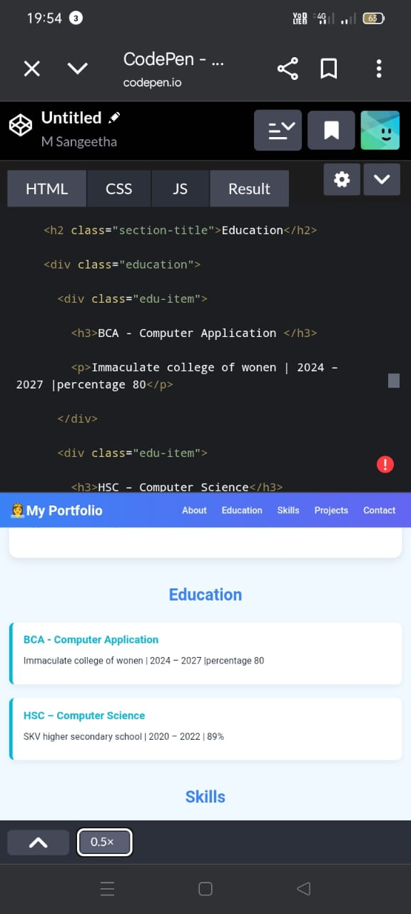
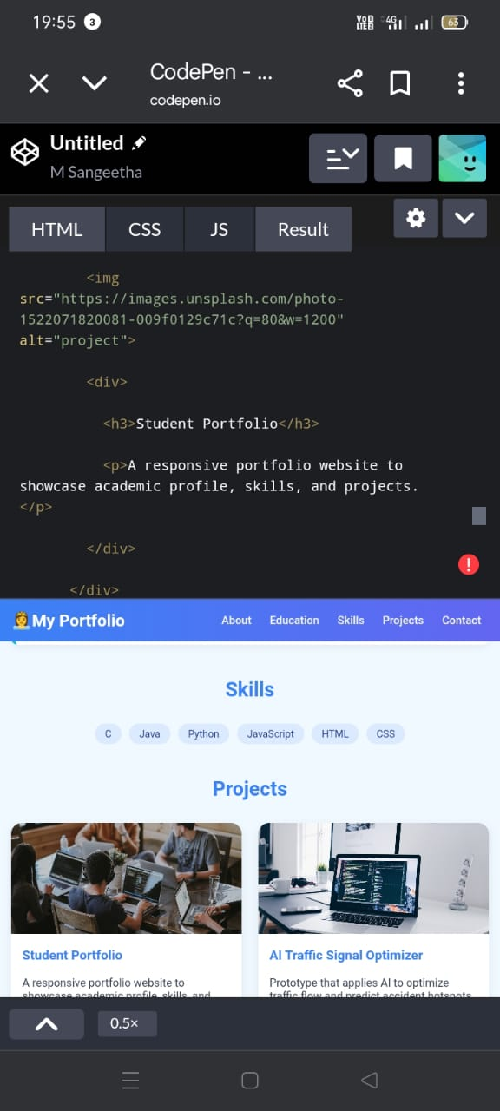
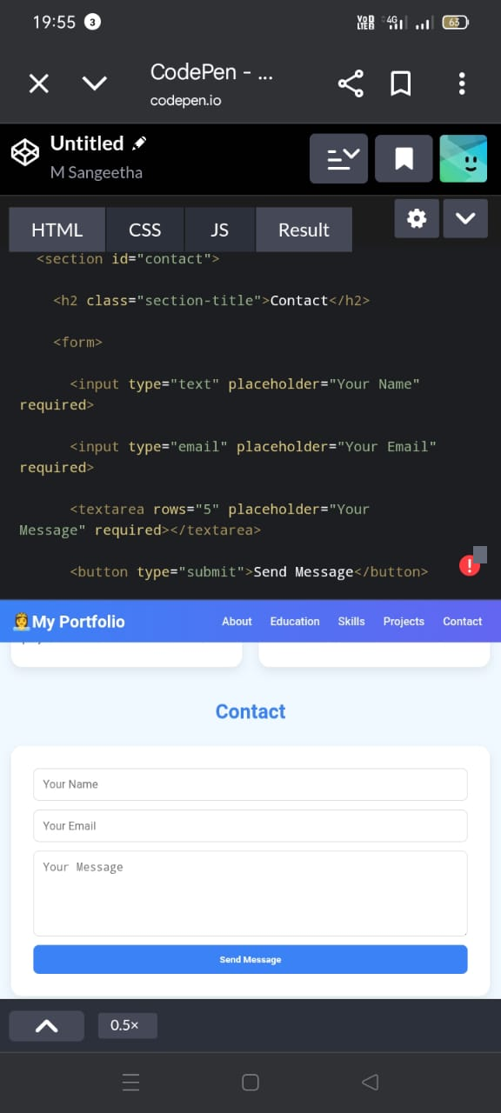
Results and screenshots

Slide 13
Conclusion
The Student Portfolio Website serves as an impactful digital platform, enabling students to present their skills, education, and projects in a structured manner.
It helps bridge the gap between students and recruiters by offering a professional, accessible, and personalized profile, thereby enhancing opportunities for internships, job placements, and academic growth.

Slide 14
Guthub link
Menakamenaka3106-svg

